Slide 1
Michigan Data Science Team
WORKSHOP 1

Slide 2
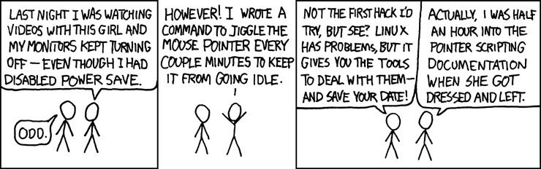
Outline
About the presenter
Setup (should have this done already!)
Terminal
Git
Python
Presented on:

Slide 3


About me
Junior in data science & electrical engineering
Windows/WSL
F
Talk to me about human-computer interaction, diversity in tech, cats,
Presented on: 09/19/2020

Slide 4
Setup
What were all those things we made you install?!

Slide 5

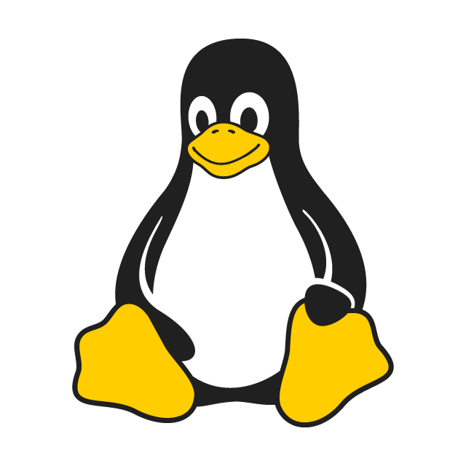

Unix
Family of operating systems, including Linux
Windows Subsytem for Linux (WSL)
Ubuntu, Redhat, etc. are distributions of Linux
Notes:
Unix and Unix-like operating systems are a family of OS’s, just like Windows or MacOS. Linux is the most popular variant of Unix, and its selling points include its customizability, easy package management, and the fact that it is free and maintained by the open-source community. Some of these features are also shared by macOS, particularly with the help of the package manager Homebrew. Windows, however, tends to be not as friendly; WSL allows users to run Linux within Windows without needing a virtual machine or dual-booting.
Ubuntu and Redhat (used by CAEN) are among the most common distributions of Linux. Distros primarily differ in their appearances, package managers, and customizations.

Slide 6



Git
Open-source version control system
GitHub, GitLab are Git hosting services
Notes:
Git is the most widely used version control system. As the name suggests, version control is used to manage different versions of code as they are being developed. Its design is suited for maintaining code versions over time and allows for programmers to collaborate on the same code.
GitHub and GitLab are software development platforms which support git and other features, allowing you to store and manage code, teams, etc. online. Since they are both git services, there are few differences between the two in day-to-day use.

Slide 7


Python/Anaconda
Python is an object-oriented programming language
Anaconda is a data science platform which includes Python, conda, and related libraries
Presented on:
Notes:
Python is one of the most popular languages used in data science applications (closely matched with R). It’s easy to learn, scalable, and provides many useful libraries. Of course, Python can be installed and used on its own; in our setup, however, we asked you to instead install anaconda.
Anaconda is a data science platform. Its install includes Python and conda, a package manager. Like mentioned before, the Python community has created a ton of useful libraries to implement code without having to write it yourself. Conda lets you easily install these packages, and Anaconda will pre-install many of them for you. Conda also helps manage virtual environments, which allows you to install multiple package versions in separate spaces for separate projects.

Slide 8
Terminal
There are two major products of Berkeley, CA -- LSD and UNIX. We don't believe this to be strictly by coincidence.

Slide 9

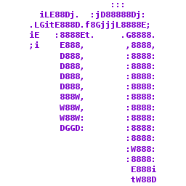


Tools
Bash is the language used by the Linux terminal
Vim and Nano are terminal text editors
Tmux is a terminal multiplexer
Notes:
Bash is the shell, or command language interpreter, used by the Linux terminal. It can handle complex scripting tasks, but its basics are most useful for managing directories, managing packages, and running scripts (and these are the primary uses for MDST).
Vim and Nano are terminal text editors, useful for viewing and editing files quickly while working in the terminal. Though they both have a learning curve, learning to use one of them will make terminal work far more convenient.
It may also be useful to try tmux, particularly for WSL users. Tmux is a terminal multiplexer, which allows multiple terminal sessions to be accessed in a single window (similar to browser windows and tabs). It can also be used to detach from terminal sessions and let code and scripts run in the background.

Slide 10

Commands
Directory Operations
pwd – print working directory
ls – list [stuff in directory]
cd DIRECTORYNAME – change directory
mkdir DIRECTORYNAME – make new directory in current one
rm FILENAME (careful!) – remove/delete
Other
Ctrl-C / Ctrl-D – interrupt/quit
sudo – gives “superuser” permissions
apt – package tool to install software
Notes:
** terminal demo the commands
These are some of the most commonly used commands for terminal use. Of course there are many more and an easy way to learn and remember them is to look up a cheat sheet.
Notes:
ls has options to show hidden files, show files of certain extension types, etc. (can find these on a cheatsheet!)
cd can take the names of subdirectories, ‘..’ for going up a directory, ‘~’ for home directory
Be careful using rm! Unlike regular file explorer delete which sends files to the recycling bin, rm is very hard to undo. May want to use some other command to send to trash. Solutions for this can also be found online (gio trash FILENAME in Ubuntu).

Slide 11
Git
In case of fire: git commit, git push, leave the building

Slide 12


Workflow
Content (files, folders, etc.) is stored in repositories
Local is on your computer
Remote is online (github.com)
Branches are versions of a repository which diverge from the main version (master)

Slide 13
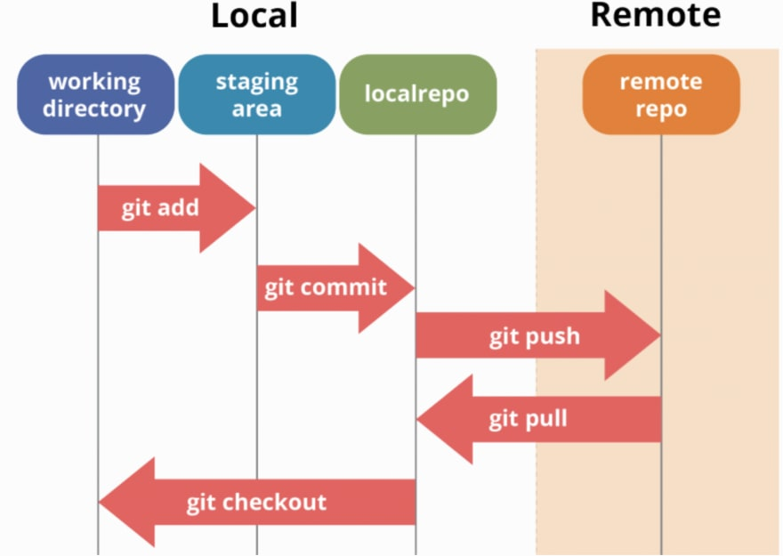
Commands
status
add
commit
push
pull
checkout
branch
Notes:
** terminal demo the commands

Slide 14
Python
Why should you take a data scientist with you into the jungle? They can take care of Python problems

Slide 15
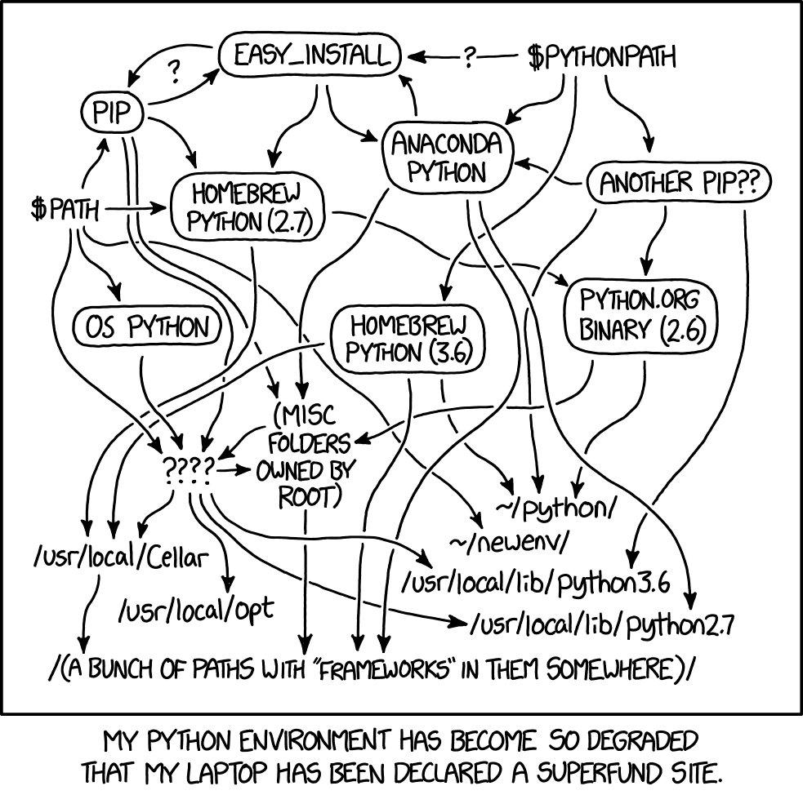
Virtual Environments
Creates separate “versions” of Python
Conda can be used to manage virtual environments
Notes:
A note about virtual environments – use them! Sometimes projects will require different libraries, especially different versions of libraries, and having isolated environments makes it easy to accommodate these differences. Plus, it makes it easy to fix problems caused by broken libraries or dependencies.
There are many python tools that manage virtual environments, including conda. Conda is both a package manager and can create virtual environments, so after using conda to create environments, it can also be used to install packages into those environments. It does not, however, support all python libraries, so there may be cases where pip is required to install those libraries. In those cases there are workarounds which can be used with caution.

Slide 16
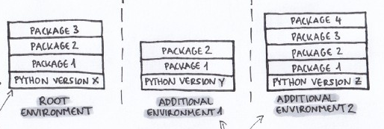
Conda
conda create --name ENVNAME
conda env create -f environment.yml
conda env list
conda activate ENVNAME
conda install PACKAGENAME
conda list
conda deactivate
Notes:
** demo in terminal

Slide 17



Python Basics
Scripts, shells, IPython
Data types
Statements and loops
Functions
Notes:
Python can be run as a script (from a file) directly from the terminal. **demo create and run simple script (hello world)
Also can run as a shell. **demo commands in shell (maybe some math)
IPython stands for interactive python, which is pretty much a pretty version of the shell. Jupyter was a spin-off from Ipython and is an interactive, notebook-style front end for it. **Jupyter demo

